Slide 2
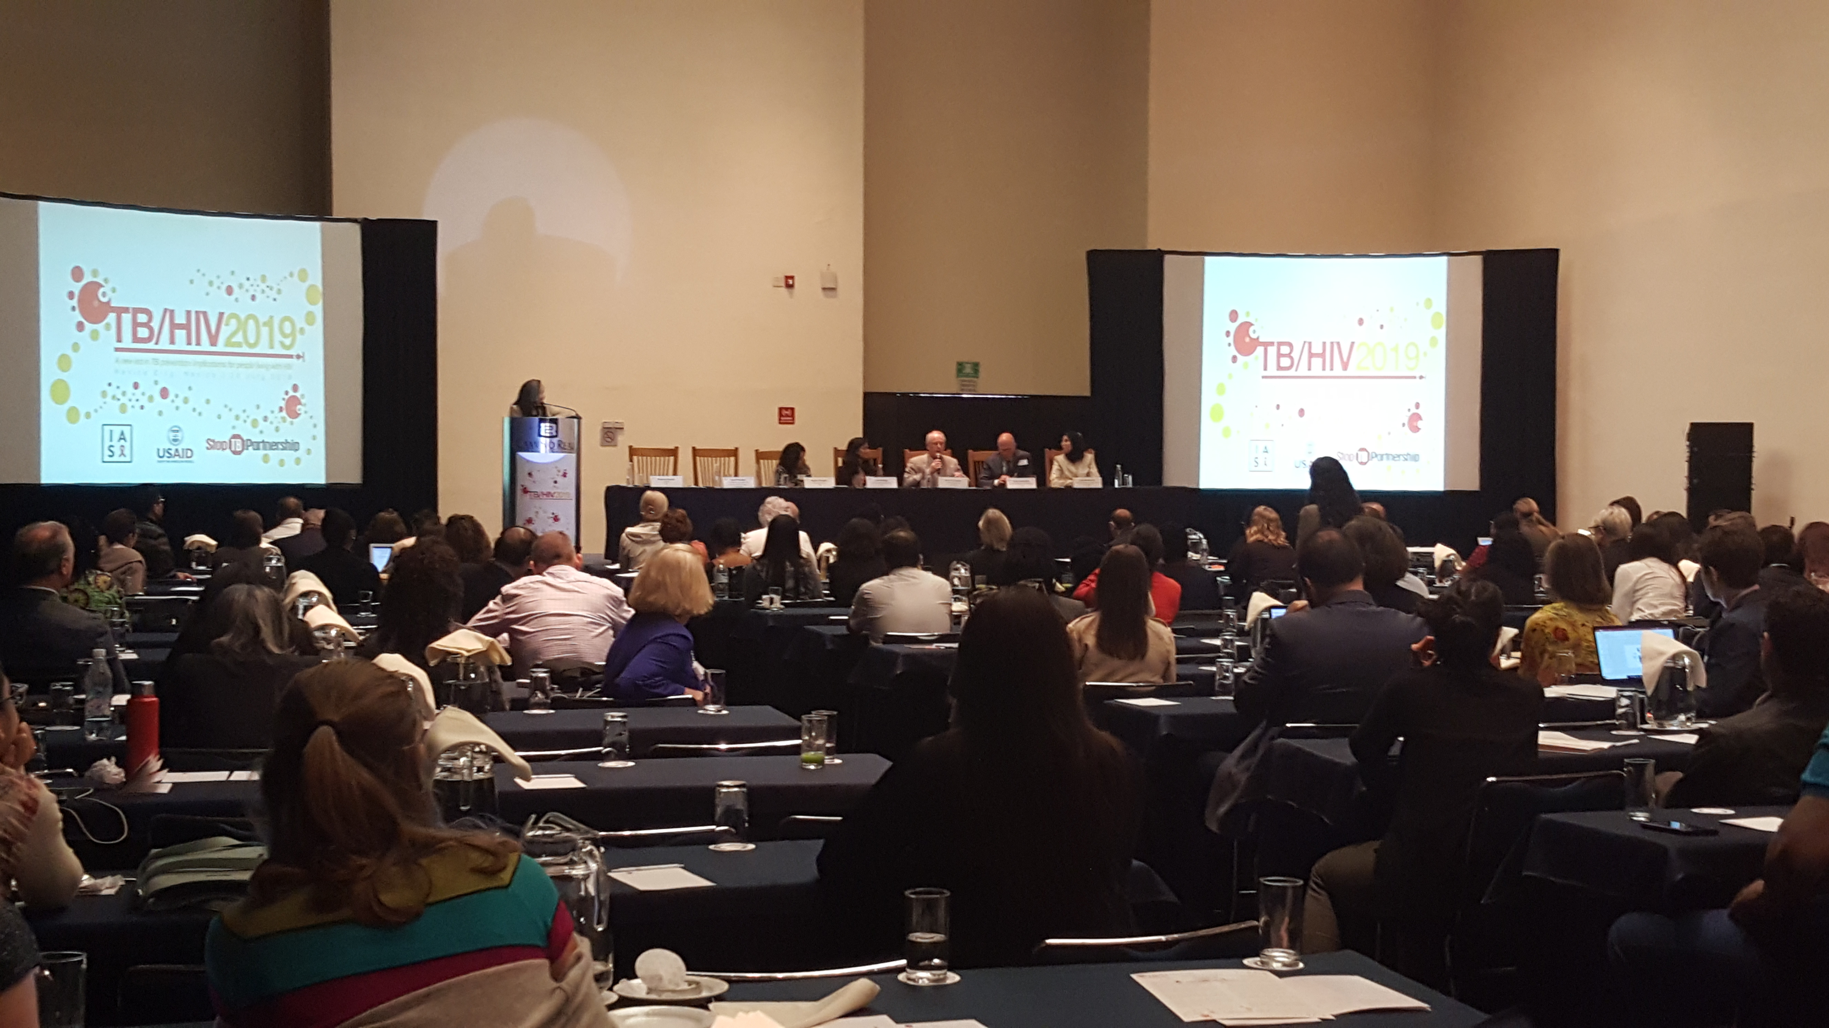
Highlights from the IAS TB/HIV 2019 symposium
IAS 2019-Mexico
Monday, July 22nd July, 2019
Lucia González Fernández, IAS, Geneva

Slide 3
POOR QUALITY OF TUBERCULOSIS CARE
PROCESS OF CARE
QUALITY IMPACT
2 Months
Costs
DIAGNOSTIC DELAY
Wait times
10.0 MILLION
new cases
558 000 new
MDR/RR-TB cases
1/2
1/5
1/5
Drug Susceptible TB
MDR-TB
LTBI
Satisfaction (Additional research needed)
Only
DIAGNOSED
&TREATED
(ADEQUATELY)
TB PATIENTS SPENT
>1/2
annual income
ON CARE
$
1.6 million deaths
Case fatality = 16%
230 000 MDR/RR-TB deaths
Patients lost to follow-up:
4%-38%
POPULATION
GOVERNANCE
PLATFORMS
PROVIDERS
TOOLS
52% HBCs recommend Xpert MTB/RIF as initial test. 47% have implemented this.
1.1 microscopy labs per 100,000
1.3 DST per 5 million
Limited accessibility to TB services at community level
3 health care providers seen before diagnosis
28% - 45%
of providers correctly manage tuberculosis cases
10 sputum smears for every Xpert test in HBCs.
20% are
receiving bedaquiline and delamanid
50-60%
patients begin seeking care in
informal & private sectors
In 8 low-income HBCs, domestic funding represents < 7% of NTP budget needs
FOUNDATIONS
Adapted from Figure 1; Reid, MJA et al (2019). Building a tuberculosis-free world: The Lancet Commission on tuberculosis
Sources: Populations: Chin, D et al, (2017). Governance: Out of Step, Stop TB Partnership (2017), Stop TB Partnership (2014). Platforms: WHO (2014); Huddart, S et al (2016). Providers: Sreeramareddy, C. T., (2014); Das, J (2015); Daniels, B (2017); Sylvia, S (2017). Tools: Cazabon, D (2017); Pai, M (2017). Processes of Care: Sreeramareddy, C. T (2009); Subbaraman, R., (2016); Naidoo, P (2017); Alsdurf, H (2016); MacPherson, P., (2014). Quality Impact: Tanimura, T (2014); Onyeonoro, U. U., (2015); Naidoo, P (2015). Health Outcomes: WHO (2018)

Slide 4
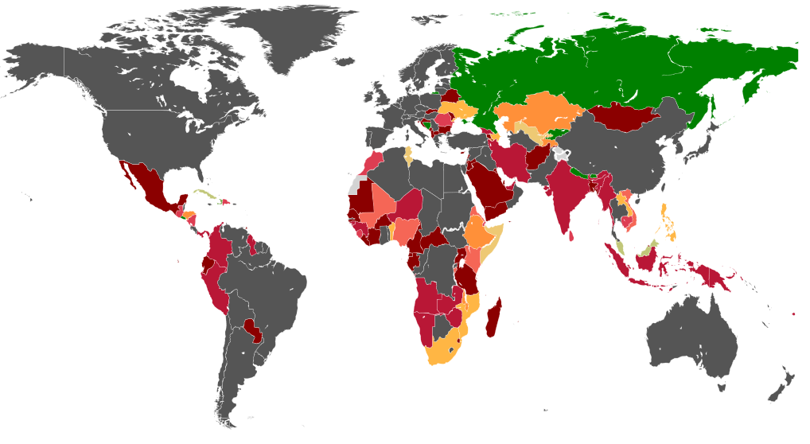
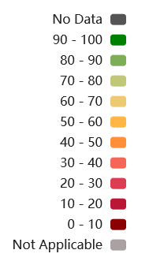
Percentage of people recently enrolled on HIV care placed on TB Preventive Therapy (TPT)
In 2017,
958 559 PLHIV received TPT
Of them 640 201 were among those newly enrolled in HIV care
Only 67 countries reported.
South Africa accounted for 39% of global TPT
Coverage
among countries reporting is 36% avg.
out of global PLHIV newly recruited on care is lower
among all in HIV care globally is even lower
Source of data: WHO database accessed Oct 2018

Slide 5
Treatment for tuberculosis infection: a cornerstone for TB elimination
TB preventive therapy effectiveness well known for more than 60 years
“Forgotten” health intervention
Gaining momentum in global health as a key strategy to decrease burden of disease, mortality and progress towards TB elimination
The 2018 HLM on TB set up a target of 6 million PLHIV to treat

Slide 6
Treatment of TB infection: TB preventive therapy
“Old option”: 6m INH
Widely available
Low uptake and variable treatment outcomes
Infrequent grades 3-4 side effects
Compatible with all ART
New voices:
Long and “not friendly enough regimen”
Manageable but relatively common side effects

Slide 7
Treatment of TB infection: TB preventive therapy
“New options”:
Rifapentine: 3HP, 1HP
Generics not available
Paediatric formulations not available
Short course rifampicin:
4R
3RH: children
The future: use of injectable depot formulations

Slide 8
Current Options for TB Preventive Therapy (TPT) in PLHIV
Drug(s)/Regimen | Guidelines | Drug-Drug Interaction Issues
Isoniazid 9 months (9H)* Isoniazid 6 months (6H)* Isoniazid > 36 months (36H)* | CDC, USPHS WHO, BHIVA, WHO, SA, Malawi | Efavirenz – increased exposure
Rifampin 3-4 months (3-4R)* Rifampin/isoniazid 3 months (3HR)* | CDC, WHO CDC, WHO, BHIVA | EFV – safe to use NVP – do not use TAF – probably safe PIs – do not use RTG and DTG – safe to use
Rifapentine/isoniazid q wk x 12 (3HP) | CDC, WHO | EFV – safe to use TAF - unknown RTG and DTG – safe to use
Rifapentine/isoniazid daily x 1 month (1HP) | - | EFV – safe to use TAF – unknown RTG and DTG - unknown
Slide facilitated by Dr. Dick Chaisson
*can be used in pregnancy and in young children

Slide 9
Summary TBI in children and pregnant women
Pregnant women and children are at high risk of progressing to active TB.
Current recommendation for pregnant woman with HIV is 6-9mos of INH
How will P1078 results change guidelines?
P2001 and CS 5021 for newer regimens
Children > 2yrs can receive INH or 3HP
Ongoing studies on 3HP in children < 2yo and on 1HP, and prevention of MDR-TB
It’s time to extend the benefits of TB research to pregnant women and young children!

Slide 10
Latent drug resistant TB infection
Large global burden of MDR TB
Unclear picture in HIV co-infection
Household contacts of MDR TB index cases are at high risk of DRTB infection
Post exposure management of MDR TB contacts is required
Ongoing RCTs will provide evidence to inform policy for treatment of MDR TB infection

Slide 11
Trials of treatment for MDR TB infection (Dr. Gavin Churchyard)
 | TB-CHAMP | V-QUIN | PHOENIX
Intervention | LVF (pediatric dispersible tablet formulation) vs. placebo daily for 6 months | LVF vs placebo daily for 6 months | DLM vs INH daily for 26 weeks
Design | Cluster randomized; superiority Community-based | Cluster randomized; superiority Community-based | Cluster randomized; superiority
Target Population | 0-5 years of age regardless of TST or HIV status | All ages (including infants < 6 mo), TST + | Children 0-5 yrs, HIV +, TST/IGRA + over 5 year olds
Assumptions | LVF decreases incidence from 7 to 3.5%; 80% power | LVF decreases incidence by 70% from 3% untreated; 80% power | DLM decreases incidence by 50% from 5% to 2.5%; 90% power
Sample size | 788 HH 1565 contacts | 1326 HH 2785 contacts | 1726 HH 3452 contacts
Sites | South Africa | Viet Nam | ACTG & IMPAACT sites

Slide 12
TB vaccines
Can we do even better?
An old vaccine repurposed?
A new vaccine that prevents disease?
Dr. Willem Hanekom

Slide 13
TB vaccines
We are on the verge of new vaccines and vaccination strategies with potential to save millions of lives
BCG may be repurposed to protect adolescents and adults against TB
M72/AS01E may protect against TB disease in persons with LTBI
Discovery and early development efforts remain critical
Healthy pipeline

Slide 14
“Fast followers”: viral vectored, adjuvanted subunit and whole cell vaccines in clinical testing
Phase 1
Phase 2a
Phase 2b
Phase 3
Ad5 Ag85A
McMaster, CanSino
TB/FLU-04L
RIBSP
M72 + AS01E
GSK, Aeras
VaccaeTM
Anhui Zhifei Longcom
ChAdOx1.85A/MVA85A
Oxford, Birmingham
H56: IC31
SSI, Valneva, Aeras
DAR-901
Dartmouth
VPM 1002
SII, Max Planck, VPM, TBVI
H4: IC31
Sanofi Pasteur, SSI, Aeras
MIP
Candila, ICMR
ID93 + GLA-SE
IDRI, Wellcome Trust
RUTI
Archivel Farma, S.L
MTBVAC
Biofabri, TBVI, Zaragosa, Aeras

Slide 15
TPT and right to health
Beneficence: TPT works and all PLHIV including key populations (KP) have the right to TPT with ART and adherence support
Non-maleficence: TPT is safe and drug safety monitoring should be integrated in care – need more data on 3HP with dolutegravir on ART initiation
Autonomy: Treatment literacy on TPT is required for PLHIV with choice of TPT regimens (6H, 3HP, 3 HR)
Vertical equity

Slide 16
TPT and right to health
All PLHIV have the right to TPT integrated with ART
Access to TPT for key populations living with HIV should be scaled up with increased access to ART
Decrease cost of rifapentine to make it accessible
Ensure access to all recommended TPT regimens

Slide 17
Main take home messages
Attention to latent TB infection will be key to decrease TB burden globally and in HIV programs
The tools exist:
Current regimens: 6INH, 3RH
New regimens: rifapentine-new models of care
Vaccines
TIME TO SCALE UP

